Slide 1

Software Architecture
University of Science, VNU-HCM
Faculty of Information Technology
Assoc. Prof. TRAN Minh Triet
Department of Software Engineering
Software Analysis and Design

Slide 2
Nội dung
Introduction
Multi-layer Architecture
Multi-tier Architecture

Slide 3
1-layer
I/O
Event Handler
Main Logic
Data Processor
User
User Interface
Data X

Slide 4
2-layer
User
User
I/O
Event Handler
User Interface
User Interface
Main Logic
Data Processor
X
Data X
Data X

Slide 5
3-layer
User
User
I/O
Event Handler
I/O
Event Handler
User Interface
User Interface
Main Logic
X
X
Data Processor
DL_X
Data X
Data X

Slide 6
Layers?
GUI (Presentation) Layer
Business Logic Layer
Data Access Layer A 3-layer architecture is a logical design model that organizes the codebase of an application into three distinct, abstract layers within a single deployment unit (e.g., a single application or service). These layers are typically:
Presentation Layer: Handles the UI and user interactions.
Business Logic Layer: Implements the core functionality, rules, and workflows.
Data Access Layer: Manages interactions with the data source (e.g., database, file system).

Slide 7
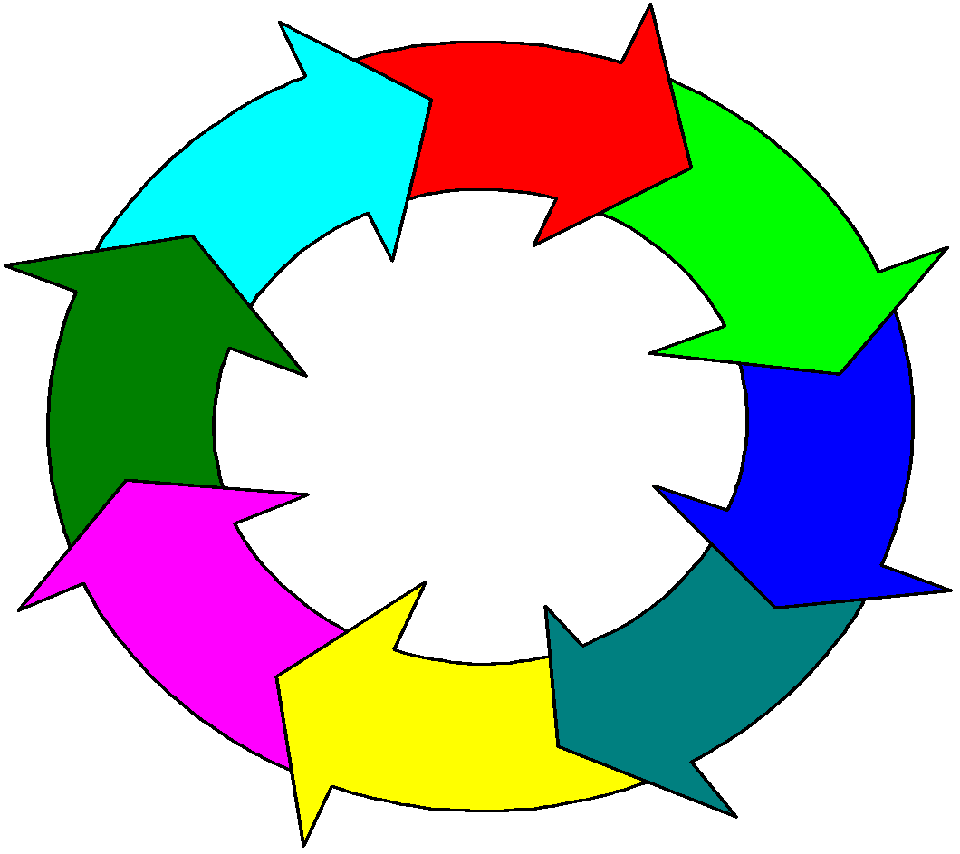
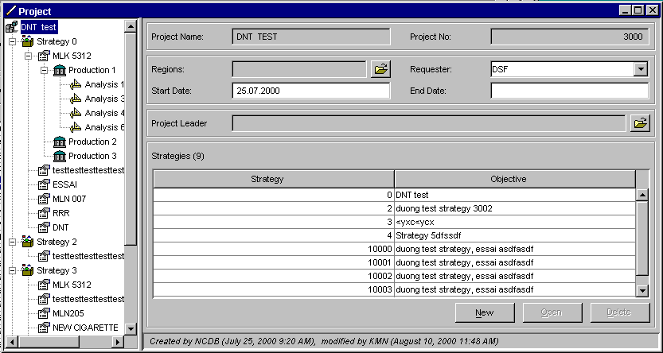
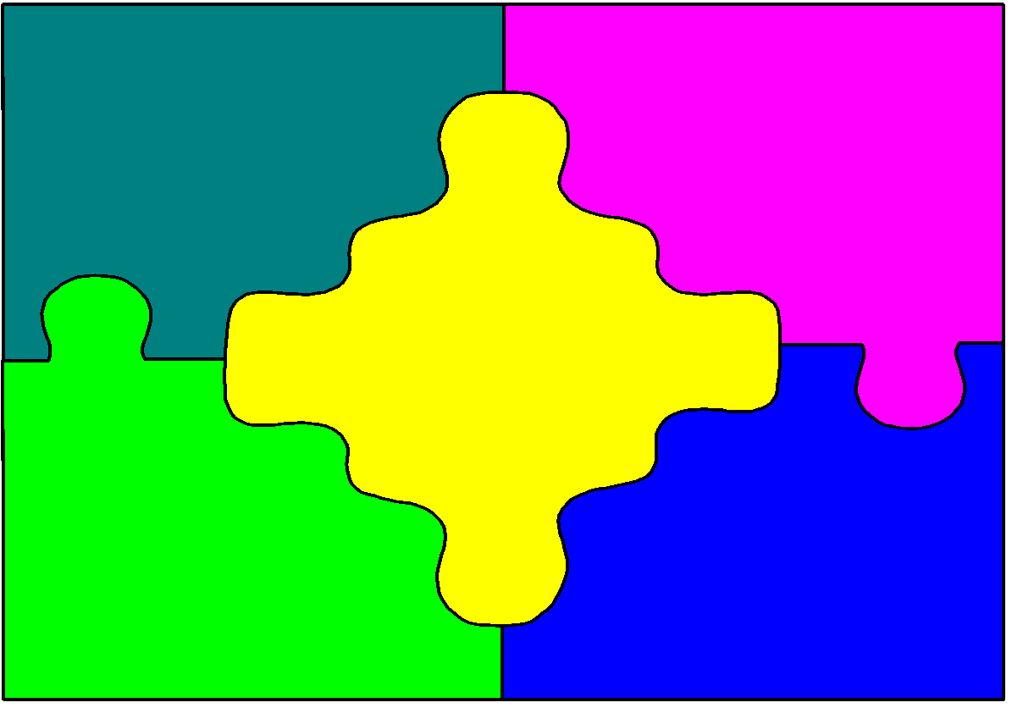
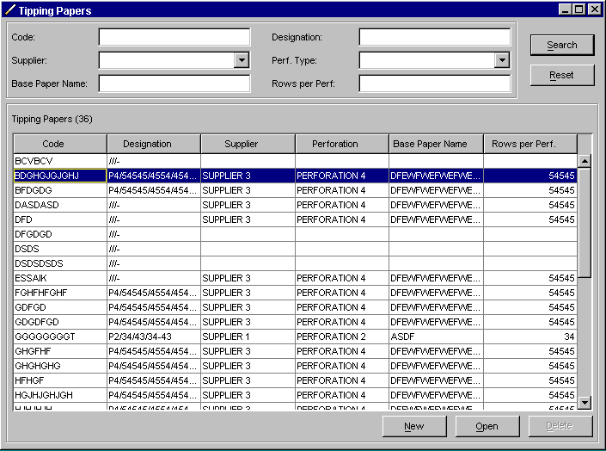
Communication between layers
GUI
Business logic
Data Access
Data Transfer Object (DTO)
Data
Raw data, data rows

Slide 8
Multi-layer Architecture
Decoupling
Re-usability
Responsibility - Delegation

Slide 9




Exception Handling
GUI
Error messages
Errors while treating data input
GUI layer Error Handling
Thrown business exceptions
Log
Business
Errors while treating in business layer
Business Error Handling
Database error codes
Database errors while executing
Database Error Handling
(controlled by DBMS)
Database

Slide 10
Nội dung
Introduction
Multi-layer Architecture
Multi-tier Architecture

Slide 11
Multi-tier Architecture
A 3-tier architecture is a physical separation of concerns, where the system is divided into three distinct tiers, each running on separate hardware or infrastructure. These tiers are typically deployed on different servers or machines.
Components:
Presentation Tier: The user interface (UI) or front-end, responsible for interacting with users (e.g., web browsers, mobile apps).
Application/Business Logic Tier: The middle tier, responsible for processing business logic, rules, and workflows (e.g., application servers, APIs).
Data Tier: The back-end, responsible for data storage, retrieval, and management (e.g., databases, file systems).

Slide 12
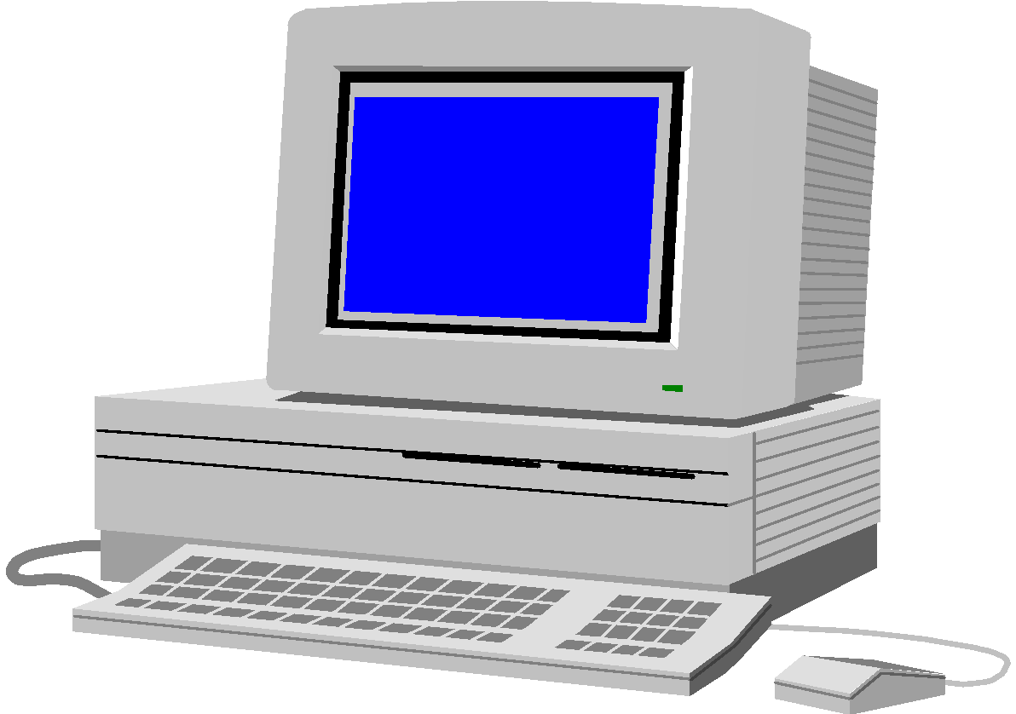
1-tier, 3-layer
Physical view
Logical view
GUI
Application + Data
Business logic
Data Access
Data

Slide 13
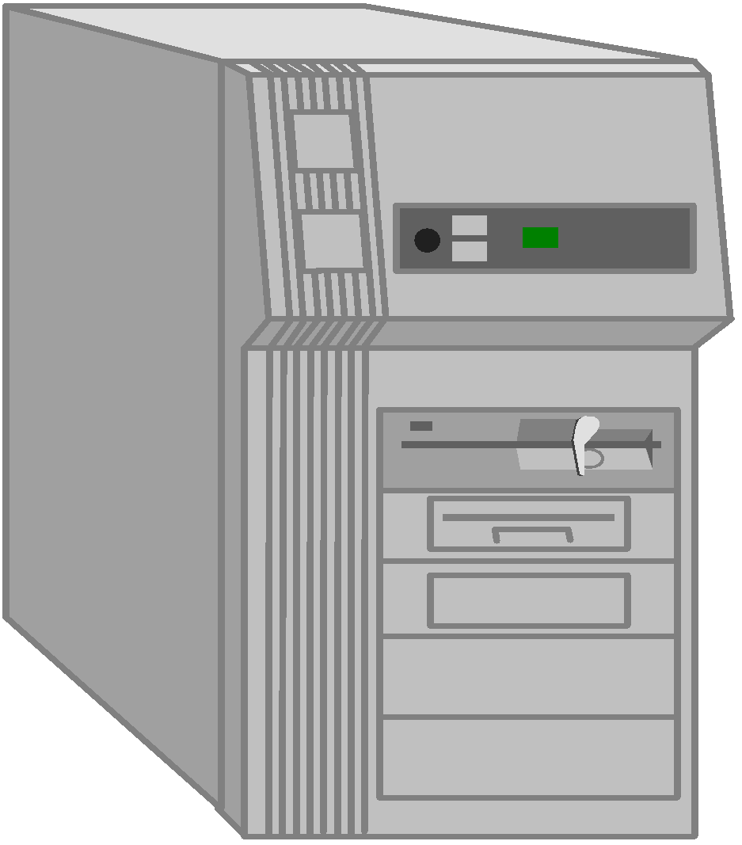

2-tier, 3-layer
Physical view
Logical view
Client tier
GUI
Business logic
Data Access
Data
Data tier

Slide 14
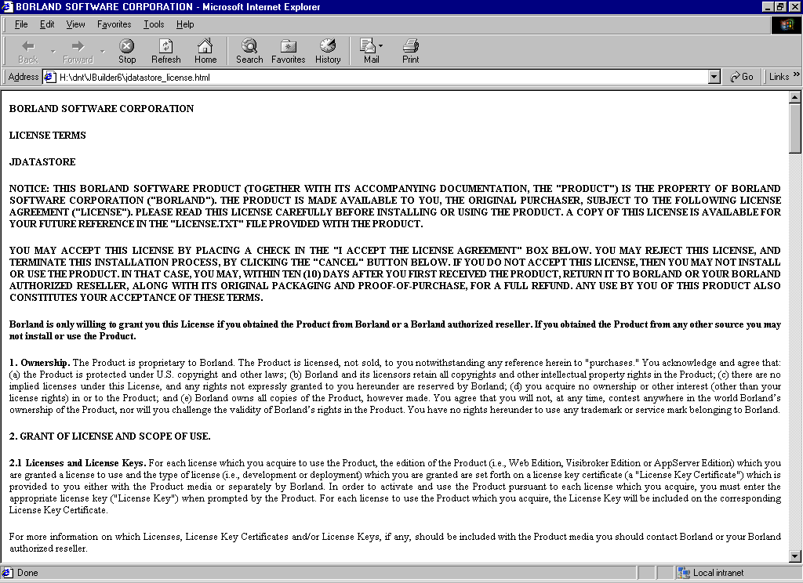
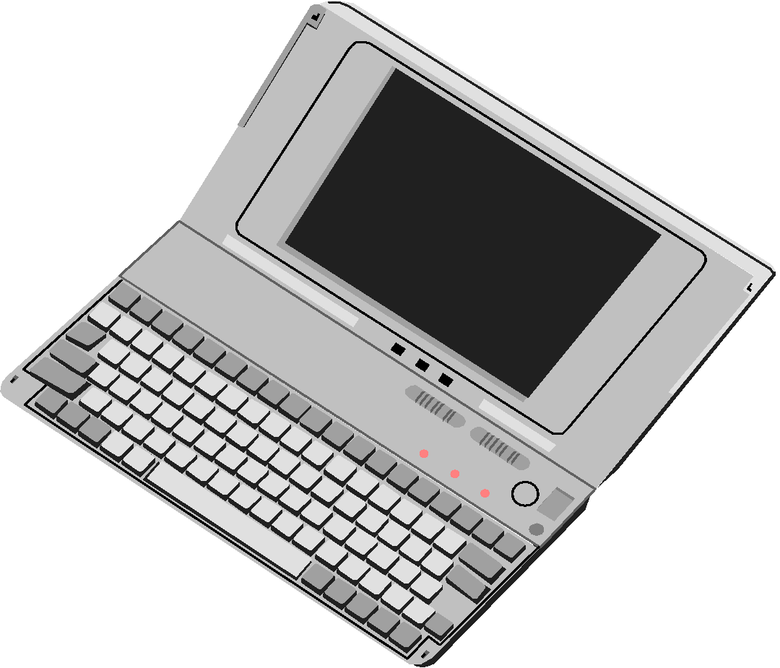




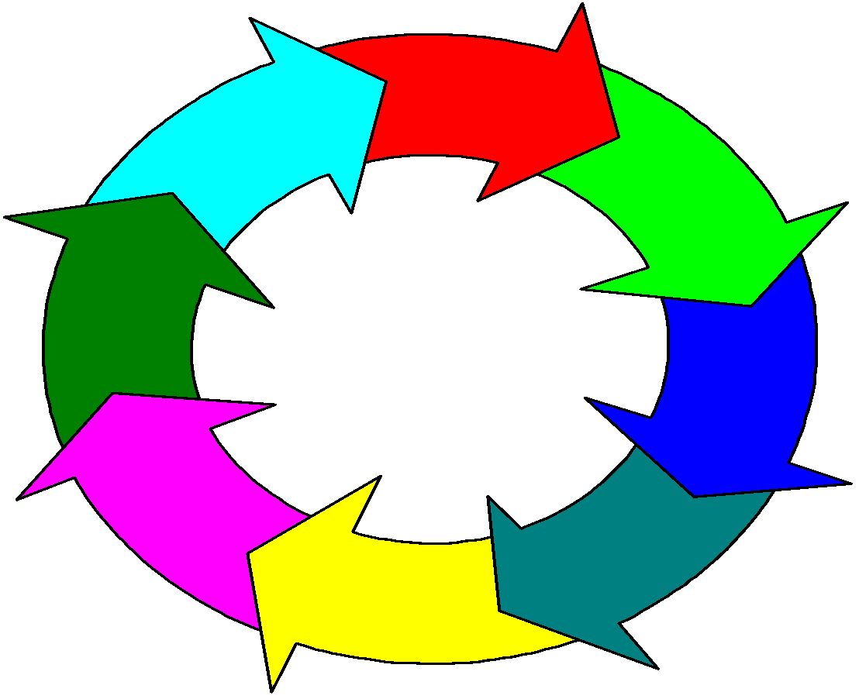

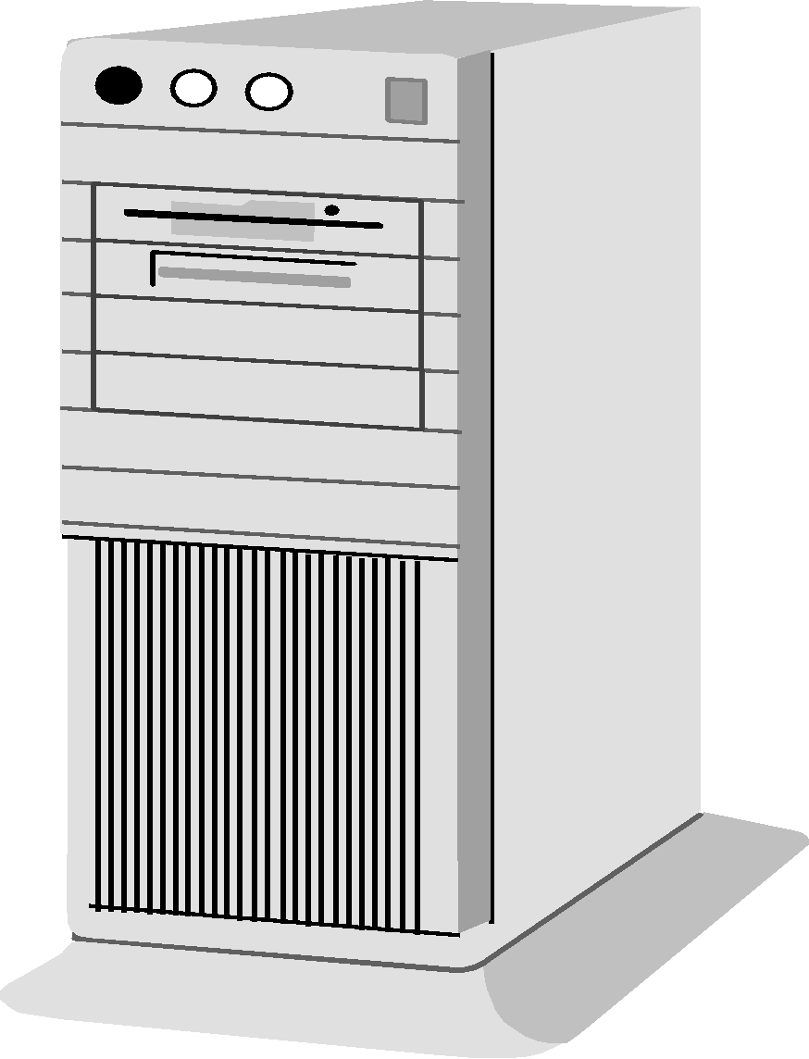
3-tier, 3-layer
Presentation tier
Browsers
GUI
Local clients
Web Server
Web Server
Application
Web
Physical view
Logical view
Business logic
Business tier
Data Access
Data tier
Data

Slide 15
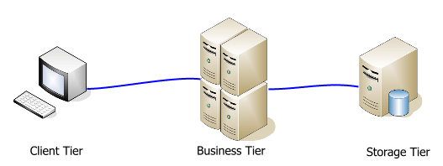
Physical tiers

Slide 16
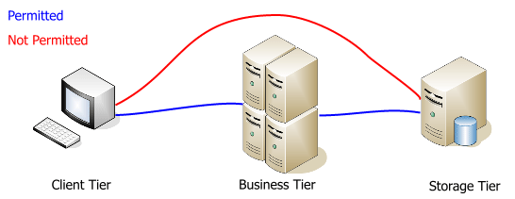
Physical tiers

Slide 17
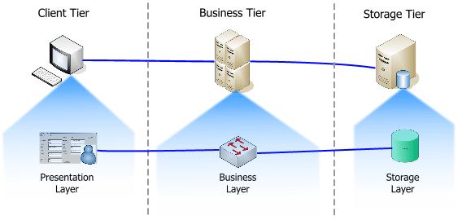
“Tiers of layers”

Slide 18
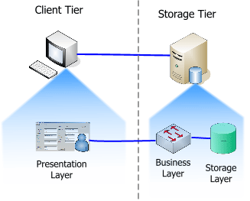
Business Layer at Storage Tier

Slide 19
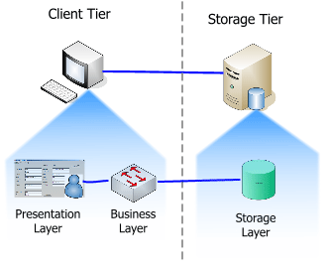
Business Layer at Client Tier

Slide 20
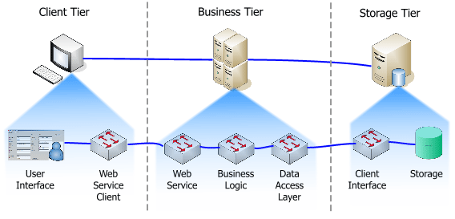
Example

Slide 21
Example
Presentation Layer
Business Layer
Data Access Layer

Slide 22
Example
Presentation Layer
Business Layer
Data Access Layer

Slide 23
Example
Presentation Layer
Business Layer
WS client
Web service
Data Access Layer

Slide 24
Example
Presentation Layer
WS client
Web service
Business Layer
Data Access Layer

Slide 25
Example
Presentation Layer
WS client
Web service
Business Layer
Data Access Layer

Slide 26
Example
Presentation Layer
WS client
Web service
Business Layer
WS client
Web service
Data Access Layer

